Slide 1
Deep Reinforcement Learning with Double Q-Learning
Anish Aralikatti Sr No: 21636
Aksheit Saxena Sr No: 21869
Shraddha S K Sr No: 21873
Sharath B S Sr No: 21857

Slide 2
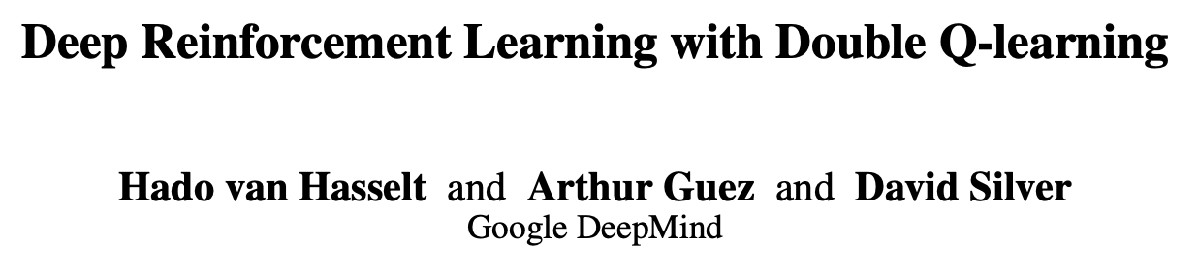
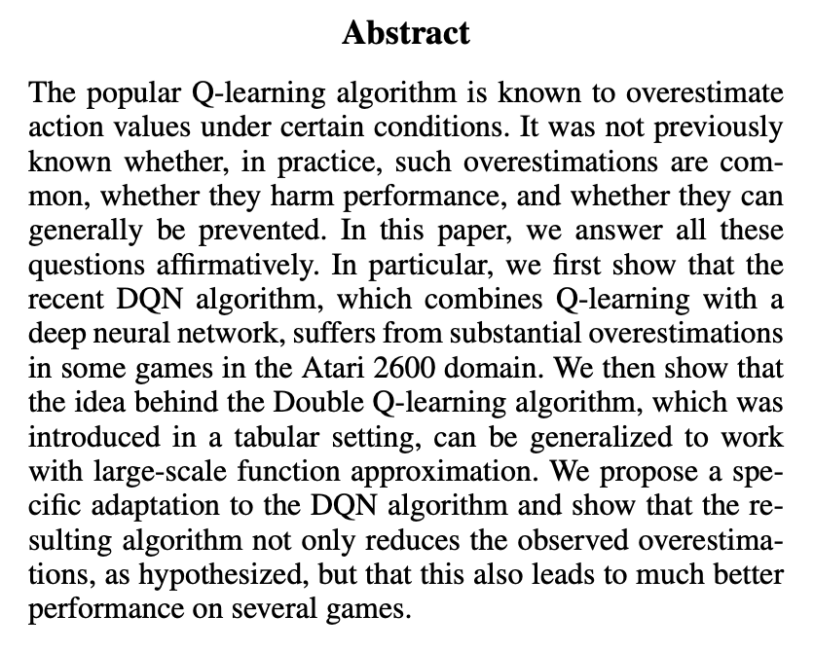
Paper Overview

Slide 3
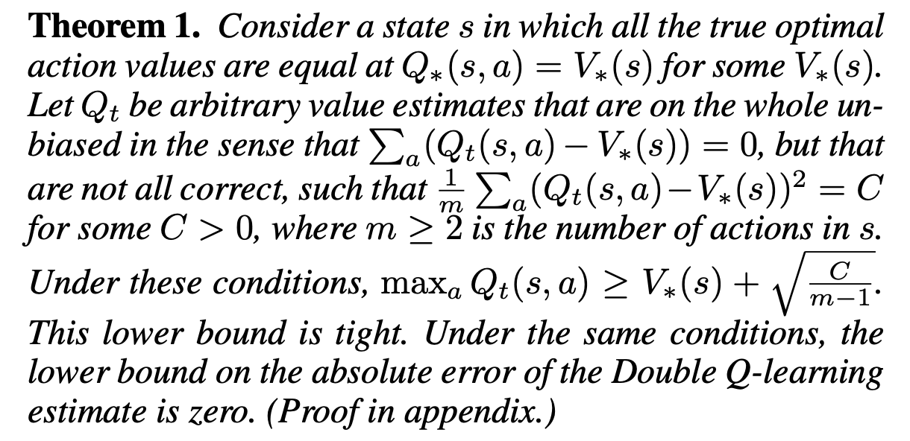

Slide 4
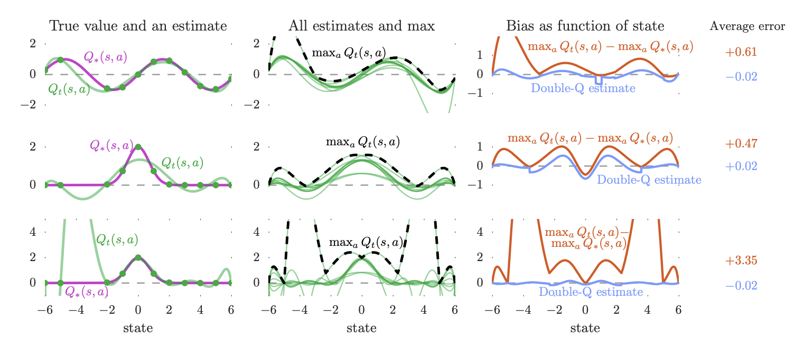

Slide 5
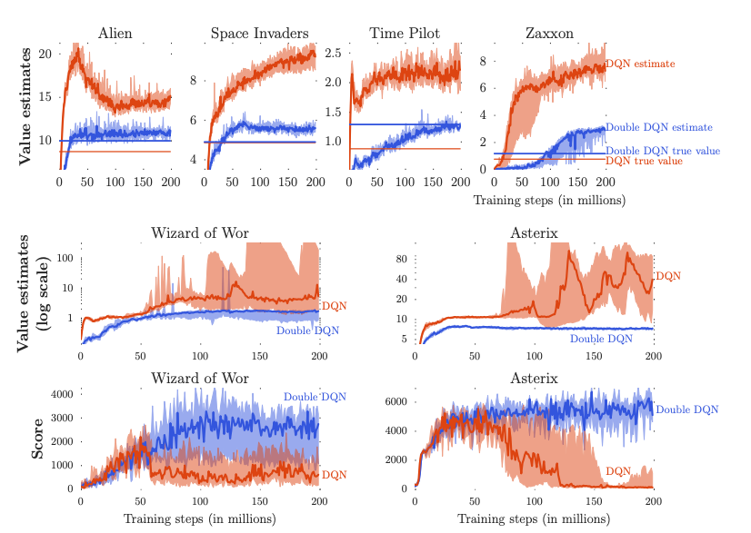
Some results comparing DQN with DDQN

Slide 6
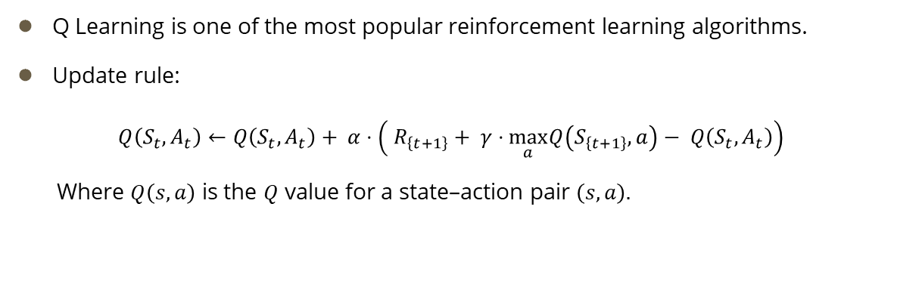
Q-Learning
Q Learning is one of the most popular reinforcement learning algorithms.
Update rule:
$$Q\left(S_{t}, A_{t}\right)←Q\left(S_{t}, A_{t}\right)+ α⋅\left.\left( R_{\left\{t+1\right\}}+ γ⋅\max_{a}Q\left(S_{\left\{t+1\right\}}, a\right)− Q\left(S_{t}, A_{t}\right)\right.\right)$$
Where $Q\left(s, a\right)$ is the $Q$ value for a state–action pair $\left(s, a\right).$

Slide 7
Deep Q-Learning (DQN)
Q-learning implemented via neural networks is termed as DQN
Why DQN?
Flexible function approximation
Low asymptotic approximation error
Deterministic environment (prevents against harmful effects of noise)

Slide 8
Issue with Q-learning?
Overestimation of action values.
High action value overestimations very common, sometimes unrealistically high
Overoptimistic value estimates would not be a problem if all values are uniformly overestimated.
If all values are uniformly higher, the relative action preferences are preserved, and the resulting policy would not be any worse.

Slide 9
Issue with Q-learning?
However, this is not the case and sometimes the overestimations are not uniform and not concentrated at states about which we wish to learn more.
Overestimation arises due to using the same set of samples to determine the maximizing action and to estimate its value.
Overestimation tends to accumulate over time, leading to an optimistic bias in the Q-values.
This optimistic bias can result in suboptimal policies and slower convergence to the optimal policy.

Slide 10
Cause of overestimations?
Believed cause of Overestimations | Experimentally justified cause of Overestimations
Overestimations have been wrongly attributed to insufficiently flexible function approximation. | Overestimations due to maximization step overestimated action values, which tends to prefer overestimated to underestimated values.

Slide 11
Double Deep Q-Learning
Double Deep Q Learning is an extension of Deep Q Learning (DQN) that aims to address the overestimation issues associated with Q-values in the original DQN algorithm.
The overestimation problem arises because during the learning process the Q-values for state-action pairs tend to be overestimated due to the max operation used in the Bellman equation.
Double Deep Q Learning mitigates this issue by decoupling the action selection and value estimation processes using 2 separate neural networks

Slide 12
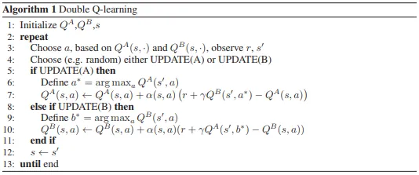
Double Q Learning Algorithm

Slide 13

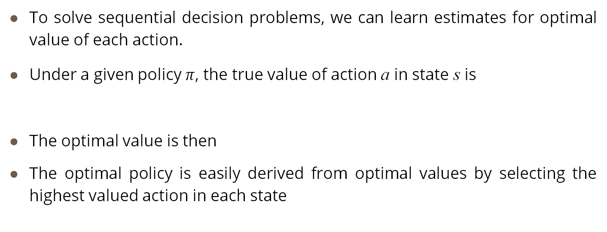
Q-Learning with Function Approximation
To solve sequential decision problems, we can learn estimates for optimal value of each action.
Under a given policy $π$, the true value of action a in state s is
The optimal value is then
The optimal policy is easily derived from optimal values by selecting the highest valued action in each state

Slide 14







Q-Learning with Function Approximation
Estimates of optimal action values can be learned using Q-learning.
Most problems are too large to learn the all action values in all states separately
Learn a parameterized value function
The Q-learning update for parameters after taking action in state and observing immediate reward and resulting state is
Where is defined as

Slide 15



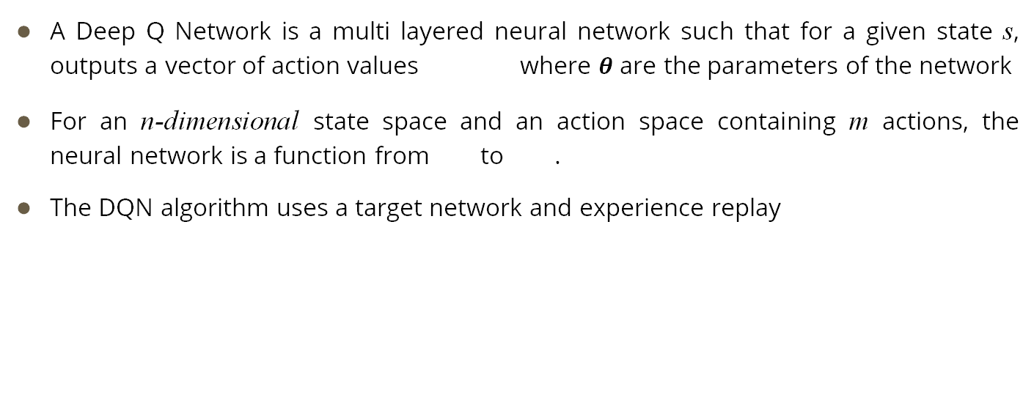
Deep Q Networks
A Deep Q Network is a multi layered neural network such that for a given state s, outputs a vector of action values where $θ$ are the parameters of the network
For an n-dimensional state space and an action space containing m actions, the neural network is a function from to .
The DQN algorithm uses a target network and experience replay

Slide 16

Target Network
Used to stabilize the training of the primary Q-network
Used to address issues related to instability and divergence that can occur during the training of DQN
The target network has parameters which is initialized to be the same as the online network at the beginning.
The parameters are copied every steps from the online network such that and kept fixed on all other steps.

Slide 17
Target Network
Without a target network, on updating the Q network’s parameters, the target values would also change continuously, leading to a moving target problem
This would make it harder for learning process to converge.
Periodic update of the target network helps stabilizing the training process by providing a more consistent target for Q-value predictions

Slide 18
Experience Replay
Experience replay is used to store and reuse past experiences
Experience at time t is denoted by e_{t} and is a tuple of the form
e_{t} = (S_{t} , A_{t} , R_{t+1} , S_{t+1})
These sample experiences are stored in the replay buffer during the training process
Generally, the agent interacts with the environment to collect experiences by taking actions in different states
Each experience is stored in the replay buffer forming a dataset of past experiences

Slide 19
Experience Replay
During training, a random batch of experiences is sampled from the replay buffer
The selected experiences are used to update the parameters of the neural network
Rather than using the most recent experiences, a random batch is sampled to which helps to break the temporal correlation between consecutive experiences and reduces the likelihood of the model overfitting on recent experiences.
Helps stabilize the training process by providing a diverse set of experiences, which in turn help faster convergence.

Slide 20

Deep Q Networks
The target used by DQN is
This is used in the Q-learning update with function approximation

Slide 21

Double Deep Q Learning
As seen earlier, the max operator in Q-learning and DQN uses the same values to select and evaluate an action
This makes it more likely to overestimate values
In Double Q learning we learn two value functions by assigning each experience randomly to update one of the two value functions
We use two Q networks with weights and
For each update, we use one set of weights to determine the greedy policy and the other to determine its value

Slide 22

Double Deep Q Learning
The target for Double Q learning with function approximation is
The selection of action is due to while we use the second set of weights to fairly evaluate the policy
The weights are updated symmetrically by switching roles of and

Slide 23



Double Deep Q Networks
Double Deep Q Networks use the online Q network for action selection to select the greedy action
Target network is used to estimate the value
The target for DDQN is
We replace the weights of the second network with that of the target network
This is used for the evaluation of the current greedy policy

Slide 24
Double Q Learning Algorithm

Slide 25
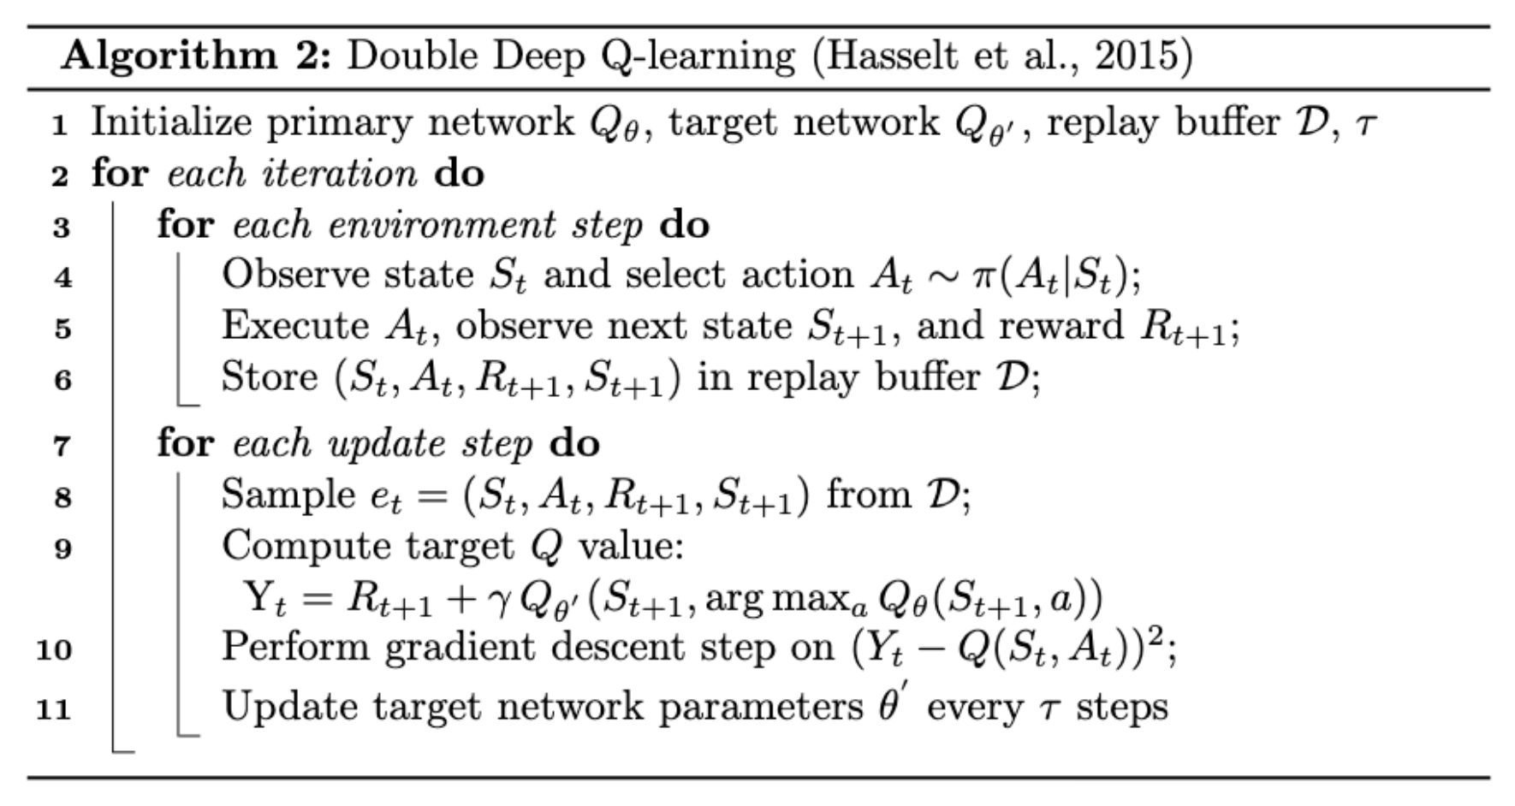
Double Deep Q Learning Algorithm

Slide 26
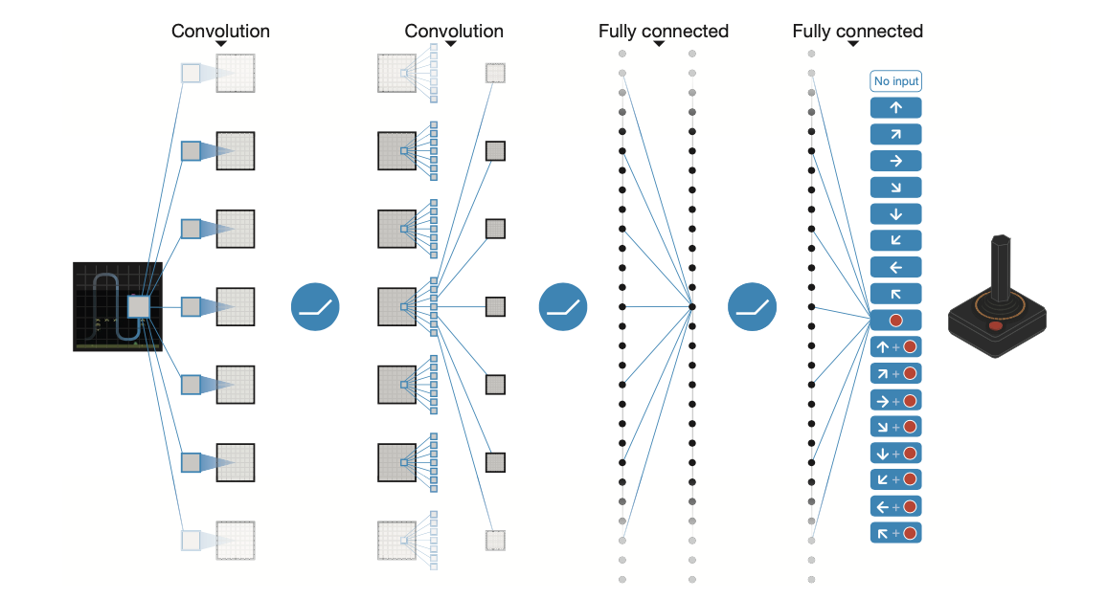
Architecture for Double Deep Q-Learning
The network architecture for DDQN is the same as that for DQN
A convolutional neural network is used with convolutional layers and fully connected layers
The input is an 84x84x4 tensor containing a rescaled and grayscale version of the last 4 frames

Slide 27
Architecture for Double Deep Q-Learning
The first convolution layer convolves the input with 32 filters of size 8 (stride 4).
The second layer has 64 filters of size 4 (stride 2)
The final convolution layer has 64 filters of size 3 (stride 1).
This is followed by a fully-connected hidden layer of 512 units.
All layers use ReLU activation
The final layer gives the Q values as output for all actions in that state
Optimizer used is RMSProp with momentum parameter = 0.95

Slide 28
Experimental Setup 1 – Cart Pole
Cart Pole is a game in which we try to balance the pole as long as possible.

Slide 29
Goal
The goal is to move the cart left and right so that the pole can stand vertically as long as possible.

Slide 30
Actions & Rewards
Actions:
○ Action 1: Push the cart to the left
○ Action 2: Push the cart to the right
Rewards:
○ A reward of +1 for every step taken.

Slide 31
States
Cart Position: [-4.8, 4.8]
Cart Velocity: (-inf, inf)
Pole Angle: [-24°, +24°]
Pole Angular Velocity: (-inf, inf)

Slide 32
Episode termination
The episode ends if any one of the following occurs:
Pole Angle is greater than ±12°
Cart Position is greater than ±2.4 i.e., center of the cart reaches the edge of the display.
Episode length is greater than 500 (200 for cartpole-v0)

Slide 33
Hyperparameters
Discount Factor: 0.95
Learning rate : 0.001
Training done: 300 Episodes
Size of experience replay memory: 2500
Epsilon: 0.01 (Decaying epsilon from 1 – 0.01)

Slide 34
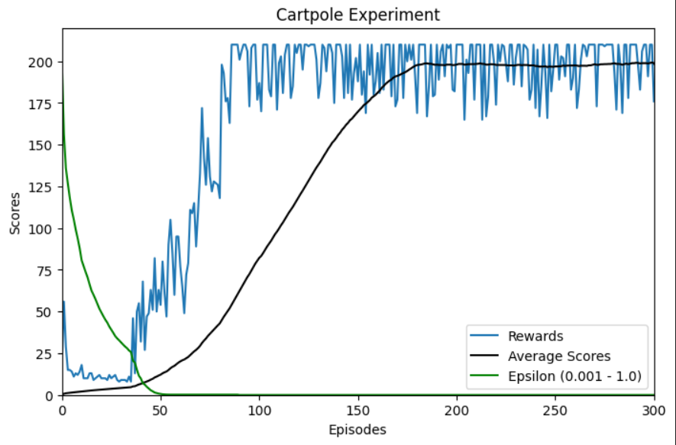
Experimental Setup 1 – Results
The maximum number of steps is clipped at 210, limiting the highest achievable score in a game to 210.
If the average reward over the past 5 episodes is > 195, move to exploitation phase.

Slide 35
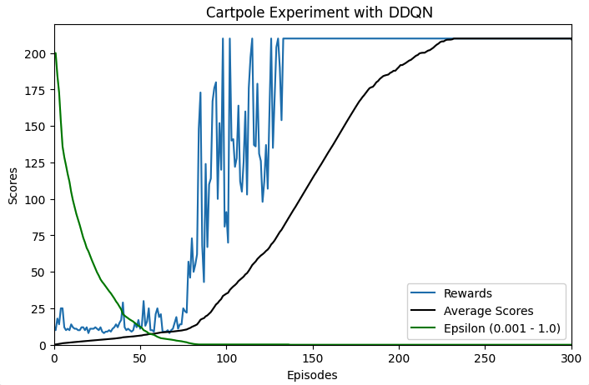
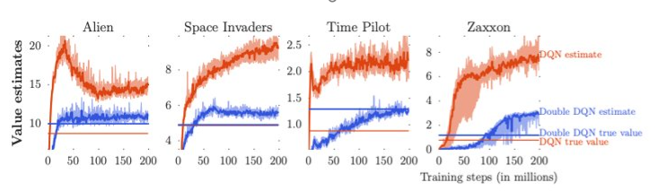
DDQN vs DQN
DDQN
DQN

Slide 36
Experimental Setup 2 – Benchmarking Algorithms
States – Internal RAM values used by the environment
Rewards – According to each game
Number of episodes: 50
Maximum number of steps within each game: 150
Atari Games
Frostbite-RAM
Asteroids-RAM
Boxing-RAM
Breakout-RAM

Slide 37
Results
Atari Game | DDQN Results | DQN Results | Random Play
Frostbite-RAM | Max reward: 60 | Max reward: 70 | Max reward: 60
Asteroids-RAM | Max reward: 90 | Max reward: 160 | Max reward: 100
Boxing-RAM | Max reward: 0 | Max reward: 5 | Max reward: 4
Breakout-RAM | Max reward: 1 | Max reward: 2 | Max reward: 0
DDQN achieves better and more stable performance than DQN after training, as it can learn more accurate Q-values and avoid suboptimal policies.
DDQN is not a general solution for all games, as it may need different hyperparameters and network architectures to achieve the best results for each game.

Slide 38
Real world applications – Financial Trading of single assets
Overestimation of bias is a type of overconfidence bias, which is a cognitive error that causes individuals to overestimate their abilities, knowledge, and the precision of their beliefs.
Overestimation of bias can lead to poor investment performance and increased risk, as it can result in excessive trading, under-diversification, and taking excessive risks, among other pitfalls.
Excessive trading can result in higher transaction costs and taxes, ultimately reducing investment returns.

Slide 39
Real world applications – Financial Trading of single assets
Under-diversification can expose investors to higher volatility and lower returns, as well as increase the chance of losing a large portion of their portfolio if one or more of their assets perform poorly.
To avoid falling prey to this cognitive trap, investors should seek objective feedback, consider contradictory evidence, and stick to a trading plan.
Recognizing and understanding overestimation of bias is crucial to making better financial decisions and improving investment returns

Slide 40
Real world applications – Optimal Execution
Optimal execution is the problem of executing a large order over a given time horizon, considering the price impact, market volatility, and trading costs.
Overestimation of bias is the tendency to overestimate the value of the optimal action, which can result from the approximation errors or noise in the value function estimator.
Overestimation of bias can lead to higher execution costs and lower profits, as it can cause the agent to execute the order too aggressively or too conservatively, depending on the sign of the bias, and thus deviate from the optimal execution strategy.

Slide 41
References
[1] Hasselt, H. van, Guez, A., & Silver, D. (2015). Deep Reinforcement Learning with Double Q-learning. arXiv preprint arXiv:1509.06461.
[2] Mnih V, Kavukcuoglu K, Silver D, Rusu AA, Veness J, Bellemare MG, Graves A, Riedmiller M, Fidjeland AK, Ostrovski G, Petersen S, Beattie C, Sadik A, Antonoglou I, King H, Kumaran D, Wierstra D, Legg S, Hassabis D. Human-level control through deep reinforcement learning. Nature. 2015 Feb 26;518(7540):529-33. doi: 10.1038/nature14236. PMID: 25719670.
[3] Frensi Zejnullahu, Maurice Moser,Joerg Osterrieder (2022) Applications of Reinforcement Learning in Finance Trading with Double Deep Q Network https://arxiv.org/pdf/2206.14267v1.pdf
[4] Brian Ning, Franco Ho Ting Lin, Sebastian Jaimungal, Double Deep Q-Learning for Optimal Execution https://arxiv.org/pdf/1812.06600.pdf

Slide 42
Thank You

